Slide 1


Student Details
Name : NAKKA. NAVEEN REDDY.
SKILLBUILD Email I’d : naveencherry257@gmail.com
College Name : AVANTHI INSTITUTE OF ENGINEERING AND TECHNOLOGY.
COLLEGE STATE : ANDHRA PRADESH
Internship Domain : CYBERSECURITY
Internship start & end date : 16th May,2024 – 25th June, 2024.

Slide 2

Project On Customer Keylogger Text Commands
The aim of this project is to analyze the user on any operating system and determine their moments. Keyloggers pose a significant security threat, as they can capture every keystroke typed on a device, including sensitive information.
Stolen login credentials can be used to gain unauthorized access to online accounts like bank accounts, email accounts, social media profiles, and more. Financial information captured by a keylogger can be used for fraudulent transactions or account takeovers.

Slide 3

﻿Agenda Of this Project
The purpose of this project is to evaluate the and learn and just for educational purpose only.
We are going to get:
Login Credentials for online Accounts
Personal Messages and Emails
Personal Documents and Files

Slide 4

Project Overview
The project is totally done for educational purpose and we used a virtual Kali Linux Operating System to get the logger keys for the target user.

Slide 5

﻿End Users of our Project
Our project aims to provide a comprehensive analysis of how our data or any other information is being lost in the recent times. Just by clicking or Downloading an unknown file from a known or an unknown person make the Ethiccal Hacker/ other Hacker to snitch our data from us

Slide 6

Our Solution and It's Value Proposition
Our solution is an easy thing is to trust a few not everyone. The fraudulent links and other files that we are downloading from the sources is making a step forward to lose our data or like giving our keys to the thief. We need to be cautioned and aware of all the that are happening in foreground and background of our system and other mobile and communication devices.

Slide 7

I Customized this program by some linux commands
I developed a python program as well as a Linux command to get the information of every key that we press on the keyboard of our devices which makes a sense of getting the data of our own when someone is sneeking or tries to get the data . The text command prompt will show the data that we are using to get the info of our every key. It doesn’t get the very sensitive data but gets the basic data od the user who is typing his info on the keyboard.

Slide 8

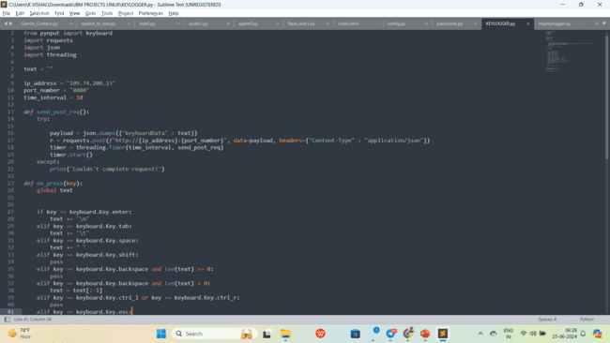
Program:
Python Program Code

Slide 9

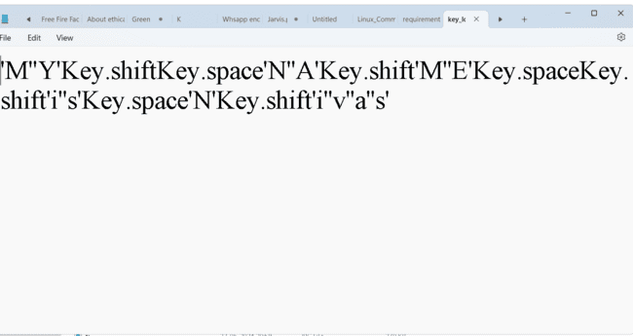
﻿Result
I just used a simple python program and a linux command to get the data from the user or the keys that they just tap, but every tap is shown on the text output to get the accurate info of the user in the base line of the text that we are using in the normal or any other device, it may get the data from external devices too.

Slide 10


﻿Link Of My Project
https://github.com/FelixFelicis468-014/Naveen-IBM-Project.git

Slide 11

Thank You!

